Slide 1

Optimizing Study Management Using : A secure web application for building and managing surveys and databases
David Bard, PhD
Biomedical and Behavioral Methodology Core (ββϺC)
Department of Pediatrics, OU College of Medicine
Rehabilitation Sciences Research Roundtable
Department of Rehabilitation Sciences, College of Allied Health
February 21, 2014

Slide 2
Presentation Outline
REDCap Overview and OUHSC History
Scenarios Favoring REDCap
Accessing REDCap at OUHSC
Security Practices and Policies
Citing REDCap in grants/IRB/manuscripts
Advanced Uses of REDCap: Time Permitting
Reports for Project Management
Reports for Outcomes
Replicable Research & Literate Programming

Slide 3
REDCap overview (http://project-redcap.org/)
Secure web application for building and managing surveys and databases.
Developed by informatics core at Vanderbilt with support from NCRR and NIH.
Designed for academic biomedical researchers.
Provides:
A centralized, back-end storage component.
Tools to create an interactive front-end html GUI.
An API to import & export data.
Example templates.
Instructional videos for training.
User-group network of institutional researchers.
Also included: built-in project calendar, scheduling module, ad hoc reporting tools, and advanced features, such as branching logic, file uploading, and calculated fields.
It can reduce
Developing a lot of new software applications.
Anxieties related to security of home-grown software.

Slide 4
A Brief History of REDCap
Slide Courtesy of: Paul Harris, PhD, Associate Professor of Biomedical Informatics, Biomedical Engineering, Vanderbilt University

Slide 5
REDCap Project History
2004 Needs Assessment
Researchers needed help managing data for small/medium sized non-trial research projects (pilot, R01, PPG)
Hypothesis
Researchers will do the right thing (secure, audit trails, etc) if provided an easy way to get needed tools
Problem
Many projects, few resources
Slide Courtesy of: Paul Harris, PhD, Associate Professor of Biomedical Informatics, Biomedical Engineering, Vanderbilt University

Slide 6
REDCap Project History
Solution:
Metadata-driven application
(no per-project programming)
2004 - First REDCap project operational at Vanderbilt
2006 - REDCap Consortium
Launched REDCap Consortium to share with other universities and foster collaboration for future development
Slide Courtesy of: Paul Harris, PhD, Associate Professor of Biomedical Informatics, Biomedical Engineering, Vanderbilt University

Slide 7
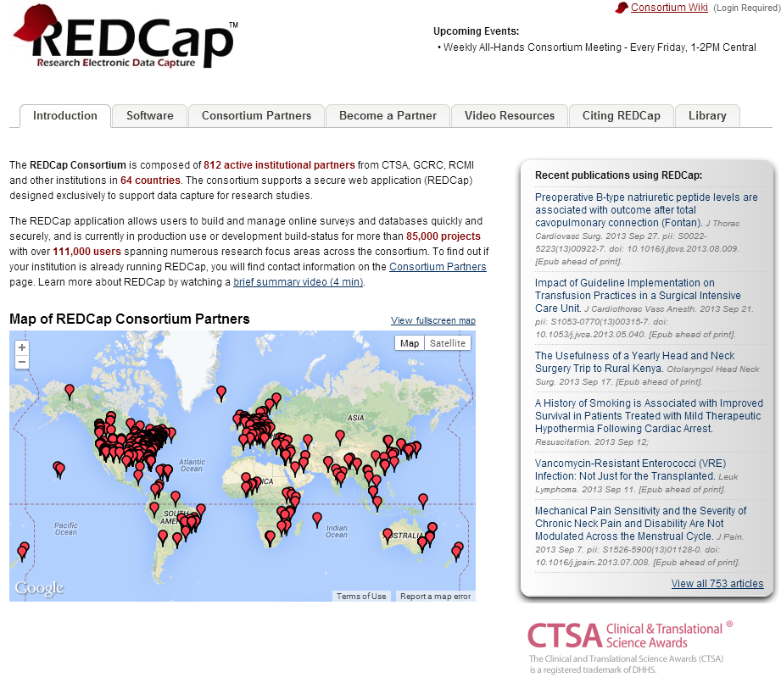
REDCap Project History
Slide Courtesy of: Paul Harris, PhD, Associate Professor of Biomedical Informatics, Biomedical Engineering, Vanderbilt University

Slide 8
A Brief Perspective:
Why REDCap?
Slide Courtesy of: Paul Harris, PhD, Associate Professor of Biomedical Informatics, Biomedical Engineering, Vanderbilt University

Slide 9
Why REDCap?
Designed for the Researcher
Slide Courtesy of: Paul Harris, PhD, Associate Professor of Biomedical Informatics, Biomedical Engineering, Vanderbilt University

Slide 10
Why REDCap?
Easy way for researchers to do the right thing (e.g. compliance, security)
Slide Courtesy of: Paul Harris, PhD, Associate Professor of Biomedical Informatics, Biomedical Engineering, Vanderbilt University

Slide 11
Why REDCap?
But Powerful!
e.g.
Data De-Identification Services
Participant Scheduling Support
Data Transfer Services & API
Graphical Data Review
Double-Data Entry
Full audit trails and logging
Shared Library (efficiency, standardization)
Multi-site Collection (sequestered access)
Data quality reports
… Constantly Evolving …
Slide Courtesy of: Paul Harris, PhD, Associate Professor of Biomedical Informatics, Biomedical Engineering, Vanderbilt University

Slide 12
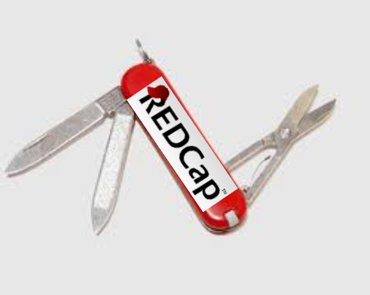
Why REDCap?
REDCap is easily configured to support a variety of single- and multi-site study needs.
Setup can be accomplished in hours if
data collection plan is in order.
Slide Courtesy of: Paul Harris, PhD, Associate Professor of Biomedical Informatics, Biomedical Engineering, Vanderbilt University

Slide 13
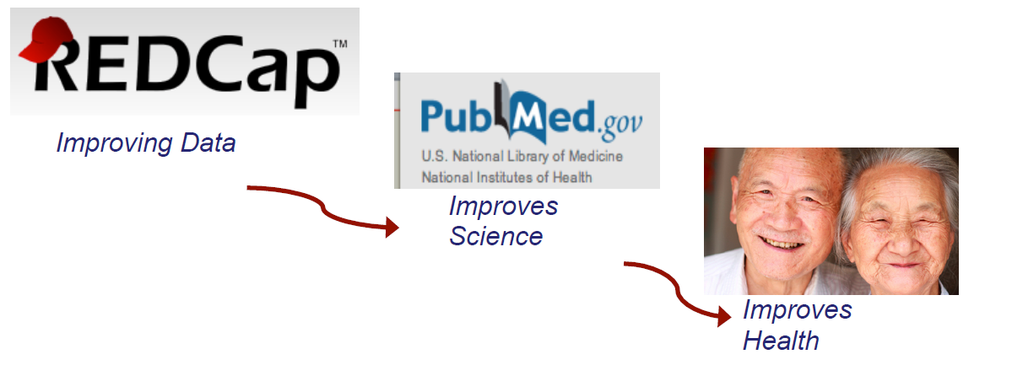
Why REDCap?
Improves science
Workflow for creating projects includes all research team members and helps solidify the data management plan before enrolling the first patient.
Slide Courtesy of: Paul Harris, PhD, Associate Professor of Biomedical Informatics, Biomedical Engineering, Vanderbilt University

Slide 14
Why REDCap?
Diversity of Supported Research
Proven Track Record in:
Slide Courtesy of: Paul Harris, PhD, Associate Professor of Biomedical Informatics, Biomedical Engineering, Vanderbilt University

Slide 15
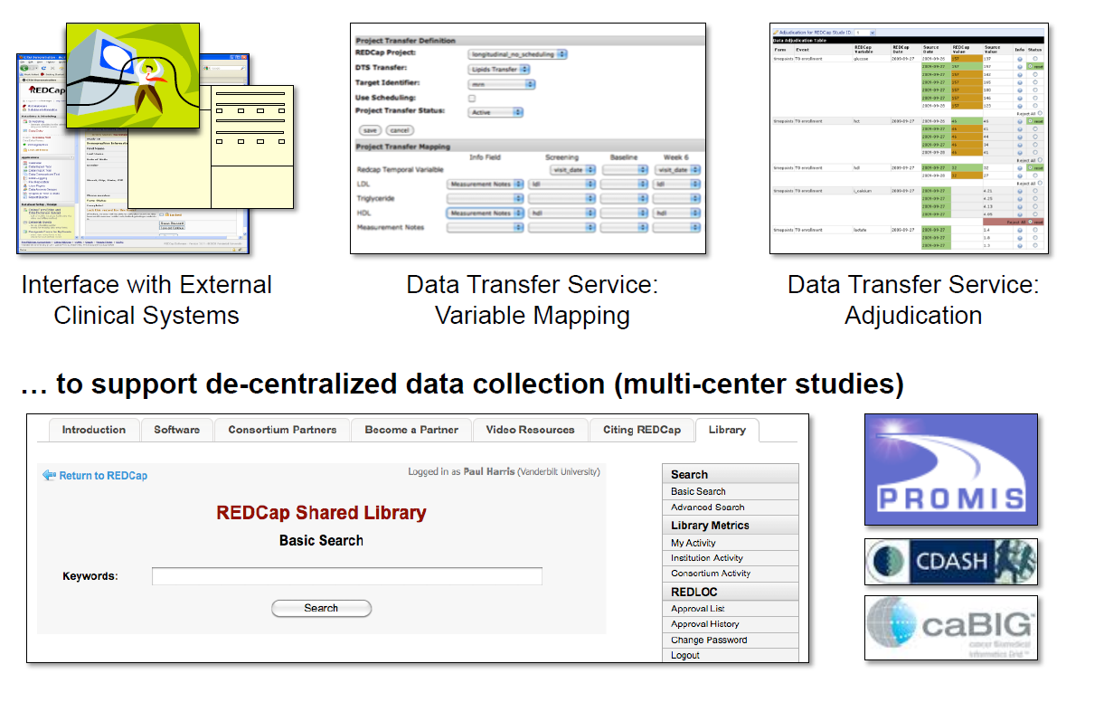
Why REDCap?
Promotes Standards and Standardization …
Slide Courtesy of: Paul Harris, PhD, Associate Professor of Biomedical Informatics, Biomedical Engineering, Vanderbilt University

Slide 16
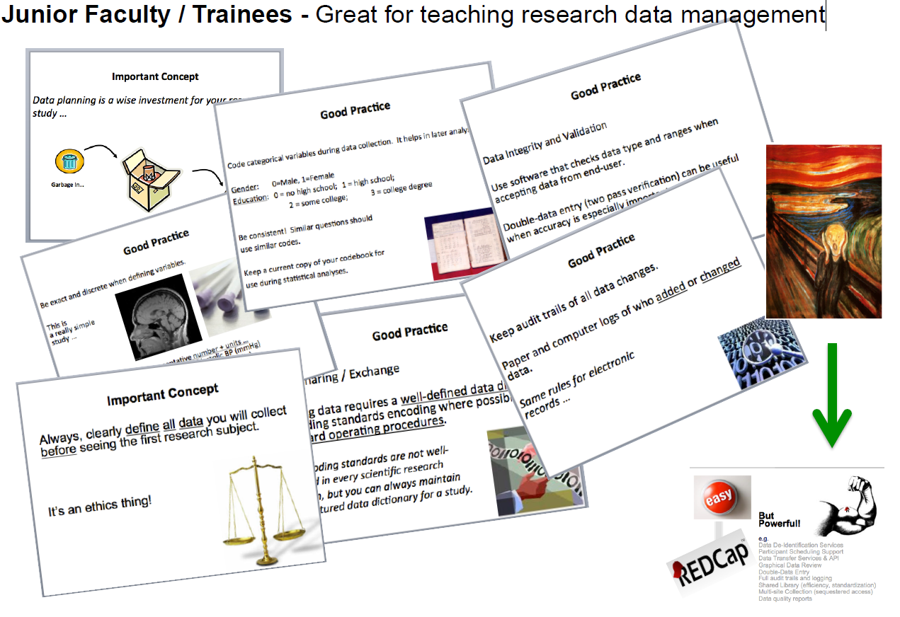
Why REDCap?
Slide Courtesy of: Paul Harris, PhD, Associate Professor of Biomedical Informatics, Biomedical Engineering, Vanderbilt University

Slide 17
Why REDCap?
Flexible: REDCap doesn’t know or care if a record represents a patient, mouse, cage …
(solid tools + smart people… amazing things happen)
Great for Multi-Center Studies
Centralized: Use Data Access Groups to Sequester
De-Centralized:
Metadata = Metadata (ad hoc standards)
Writing a grant or going to IRB?
Boilerplate language & create a REDCap shell project for screenshot
Slide Courtesy of: Paul Harris, PhD, Associate Professor of Biomedical Informatics, Biomedical Engineering, Vanderbilt University

Slide 18
Why REDCap?
Cost Effective
Setup Infrastructure is
minimal
Most sites using
REDCap leverage 1-2 personnel to support entire research enterprise
Slide Courtesy of: Paul Harris, PhD, Associate Professor of Biomedical Informatics, Biomedical Engineering, Vanderbilt University

Slide 19
A Brief History of OUHSC REDCap
Slide Courtesy of: Paul Harris, PhD, Associate Professor of Biomedical Informatics, Biomedical Engineering, Vanderbilt University

Slide 20
REDCap Software Features
Availability - Software available at no cost for REDCap partners.
Secure and web-based - Input data or build online survey anywhere in the world over secure web connection with authentication and data logging.
Multi-site access - REDCap databases/surveys can be used by researchers from multiple sites and institutions.

Slide 21
REDCap Software Features Cont.
Fast and Flexible - Conception to production-level database or survey is possible in less than a day.
Export Data in Common Formats - REDCap automatically exports data in the following formats: Excel CSV, SAS, Stata, R, and SPSS.
Fully Customizable - REDCap has the flexibility to allow total control of shaping a database or survey.

Slide 22
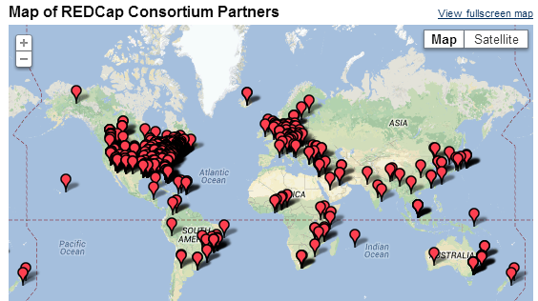
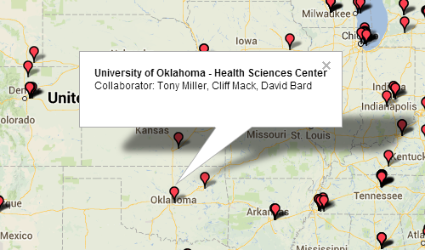
OUHSC Becomes REDCap Partner
MIECHV grant (DBP) requests REDCap (Nov. 2011)
IT installs “DBP” REDCap instance, ver.4 (Jan. 2012)
New DBP projects move to REDCap (2012-2013)
Campus REDCap interest rises (2012-2013)
IT installs “Enterprise” REDCap instance, ver.5 (Mar. 2013)
IT installs “Development box” instance, ver.5 (Apr. 2013)
Governance body requested (Mar. 2013)
Governance body formed (Jun. 2013)
Funding for REDCap admin requested (Apr. 2013)
College of Medicine agrees to fund Dev box and Enterprise instance (Jun. 2013)
REDCap freely available to all
Notes:
670 active partners in 56 countries as of June 2013
70,000 projects and 92,000 users

Slide 23
REDCap Project Types
https://miechvprojects.ouhsc.edu/redcap/index.php?action=training
Traditional Project classic model with data entry forms
Single Survey Project utilizes only one data collection instrument
Longitudinal Project multi-use data entry forms with abstract time points
Longitudinal Project + Scheduling multi-use data forms with defined time points
Operations use case for non-study/non-trial

Slide 24
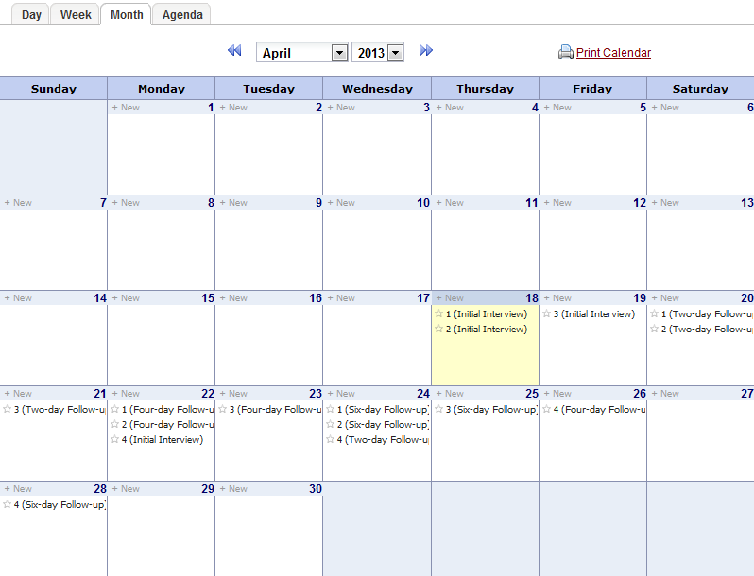
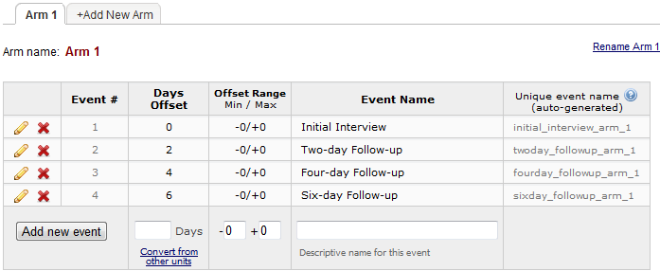
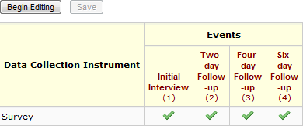
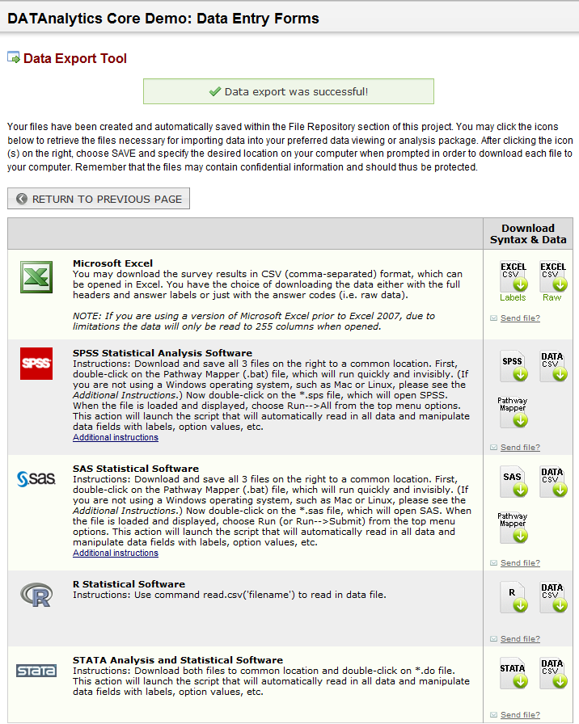
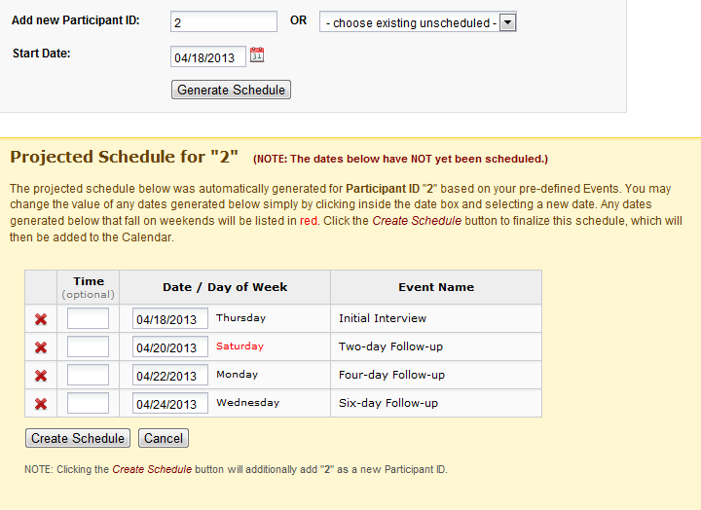
REDCap Software Highlights: At a Glance
Built-in project Calendar
Scheduling Module
(Define Events)
(Assign Instruments)
Built-in Export Formats
(Schedule Participant)

Slide 25
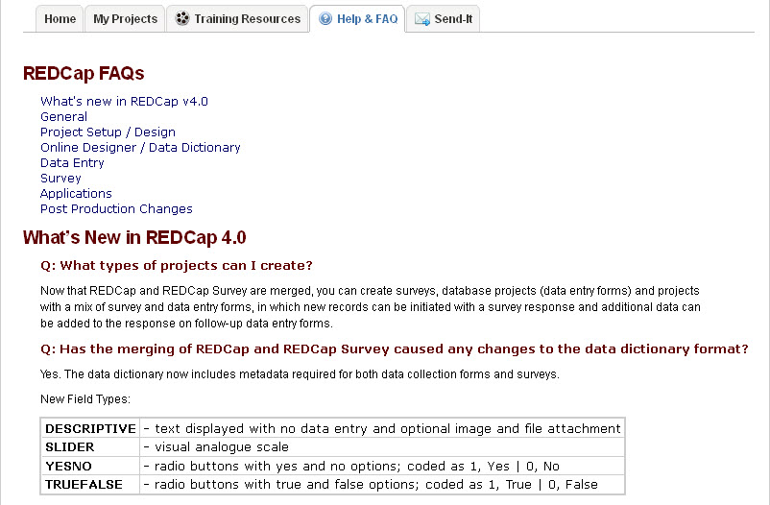
REDCap Help & FAQ
On-line User Manual is always available & up to date
Slide Courtesy of: Cathy McGraw, Cincinnatti Center for Clinical and Translational Science Training

Slide 26
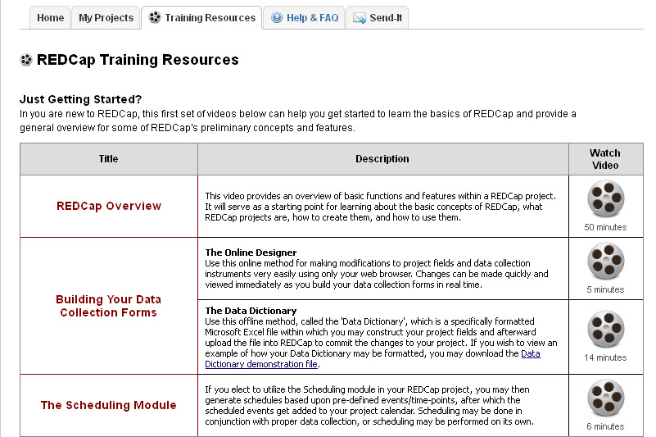
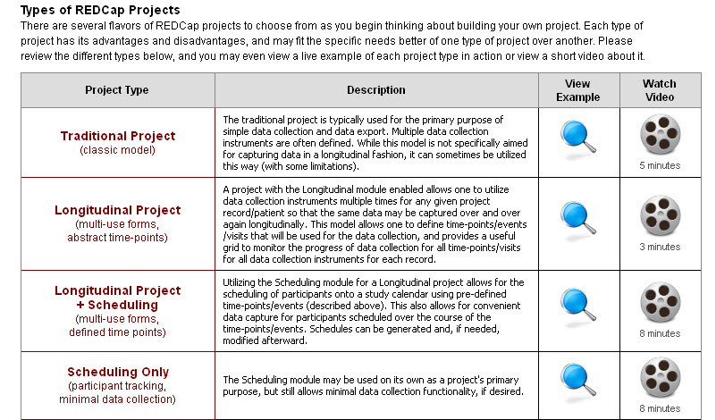
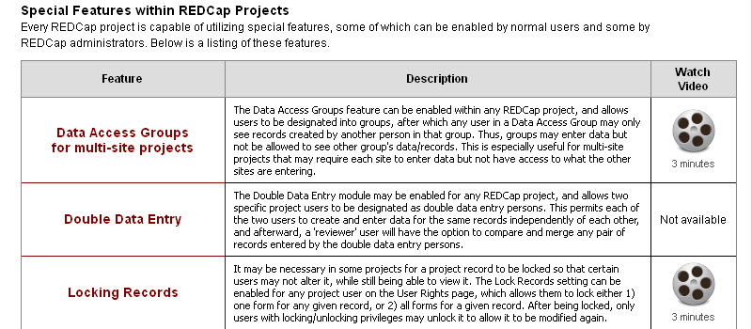
Training
Videos & examples also have links on screens where you need them
Slide Courtesy of: Cathy McGraw, Cincinnatti Center for Clinical and Translational Science Training

Slide 27
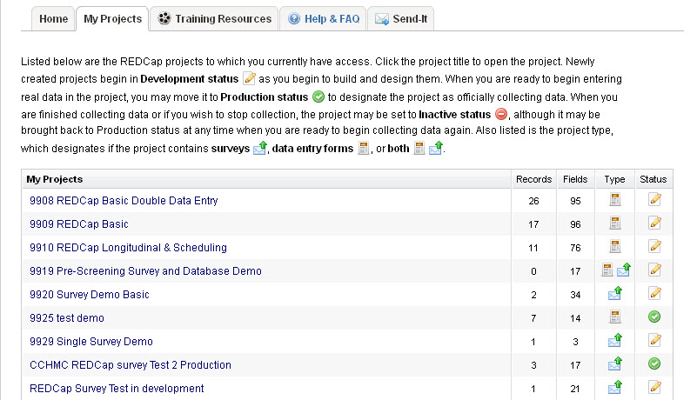
My Projects
Only projects YOU have right to see
database
survey + database
survey
Slide Courtesy of: Cathy McGraw, Cincinnatti Center for Clinical and Translational Science Training

Slide 28
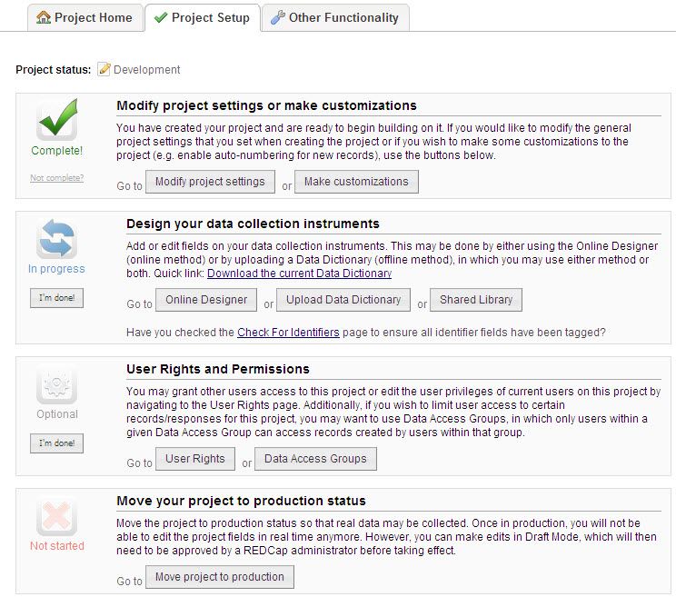
Default screen for project in development
Project Setup leads you through project creation
Slide Courtesy of: Cathy McGraw, Cincinnatti Center for Clinical and Translational Science Training

Slide 29
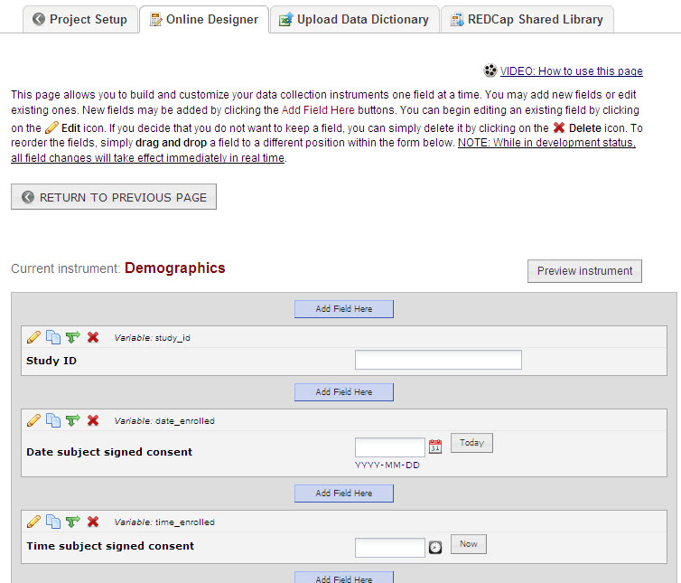
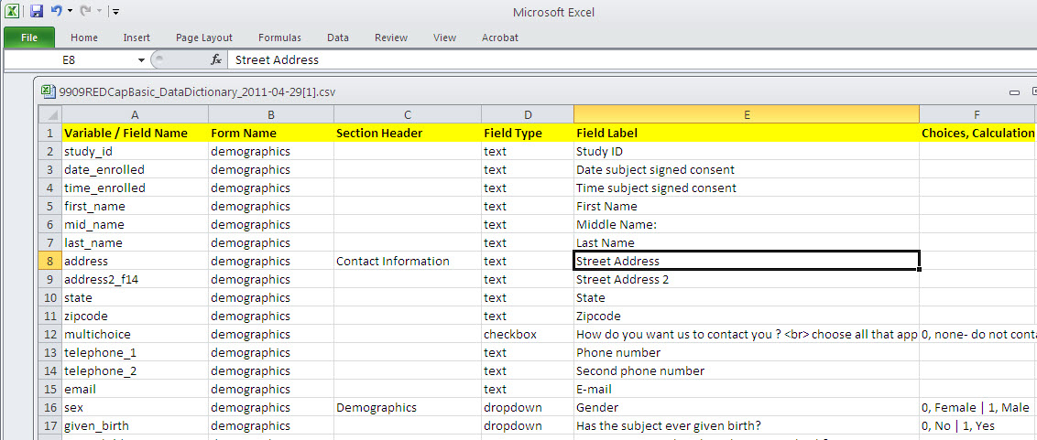
Project Setup
Library of published, validated instruments, REDCap coded,
no license fee
Data Dictionary: design forms off line in Excel grid, upload and view in real time
Online Designer:
Design forms in real time, on screen, while in development status
Slide Courtesy of: Cathy McGraw, Cincinnatti Center for Clinical and Translational Science Training

Slide 30
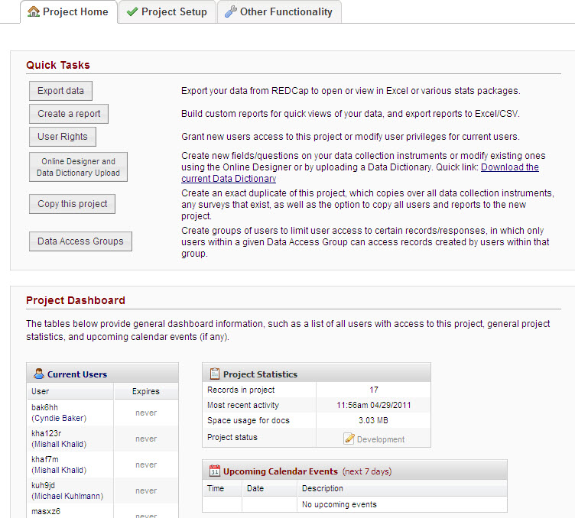
Project Home
Default for project in production
Links to features used frequently
Information on the project users and recent activity
Slide Courtesy of: Cathy McGraw, Cincinnatti Center for Clinical and Translational Science Training

Slide 31
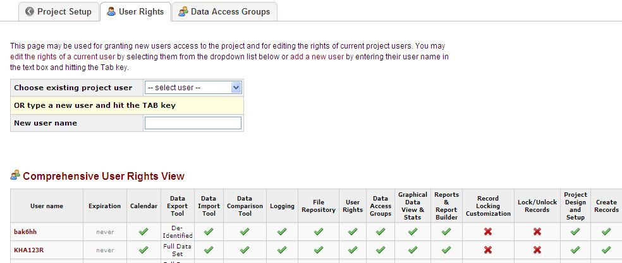
User Rights
Multi-center data can be limited to members of each group
Must be User who can login to REDCap – has System account
Project PI controls access to data: grants rights form by form, tool by tool
Slide Courtesy of: Cathy McGraw, Cincinnatti Center for Clinical and Translational Science Training

Slide 32
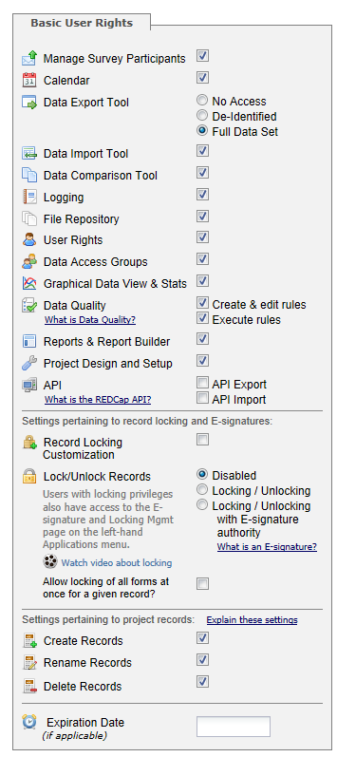
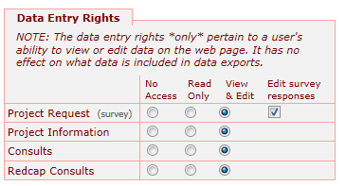
User Rights cont.
REDCap offers control over the user’s rights to the data collection instruments.
Each user’s rights are completely customizable.

Slide 33
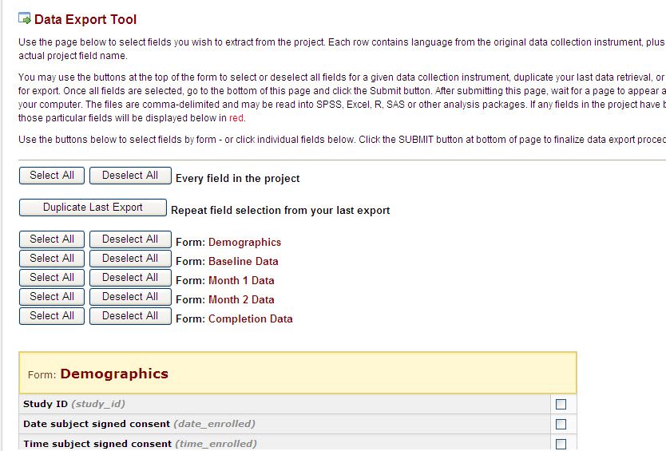
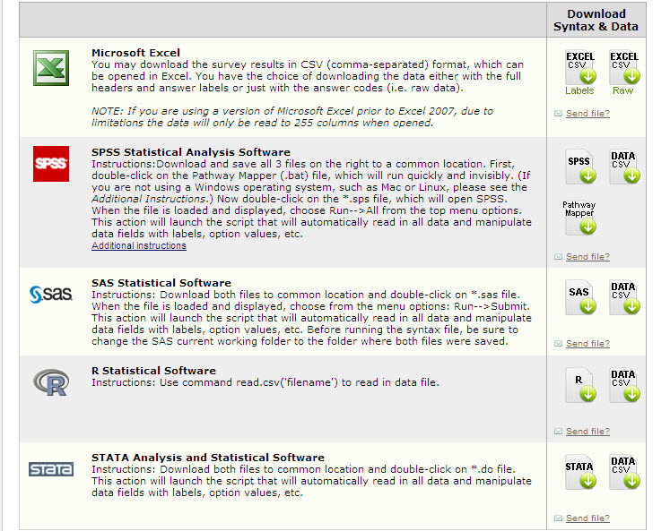
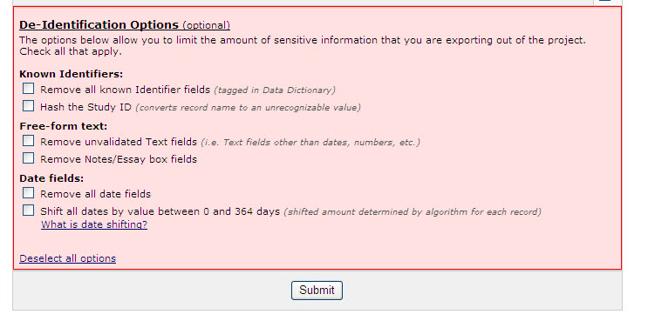
Data Export
Export controlled to field level
Options for de-identified data sets
Includes syntax files for 4 stats packages
Slide Courtesy of: Cathy McGraw, Cincinnatti Center for Clinical and Translational Science Training

Slide 34
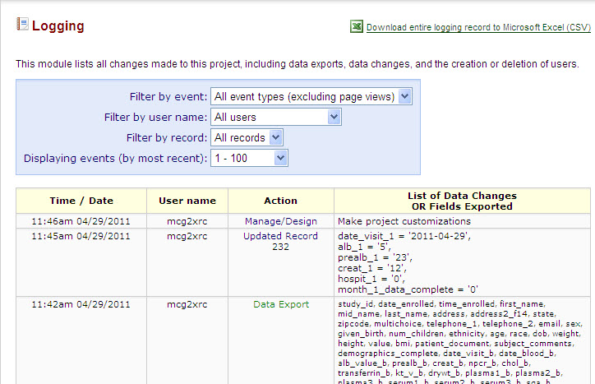
Log (Audit Trail) is HIPAA compliant and Part 11 capable
Slide Courtesy of: Cathy McGraw, Cincinnatti Center for Clinical and Translational Science Training

Slide 35
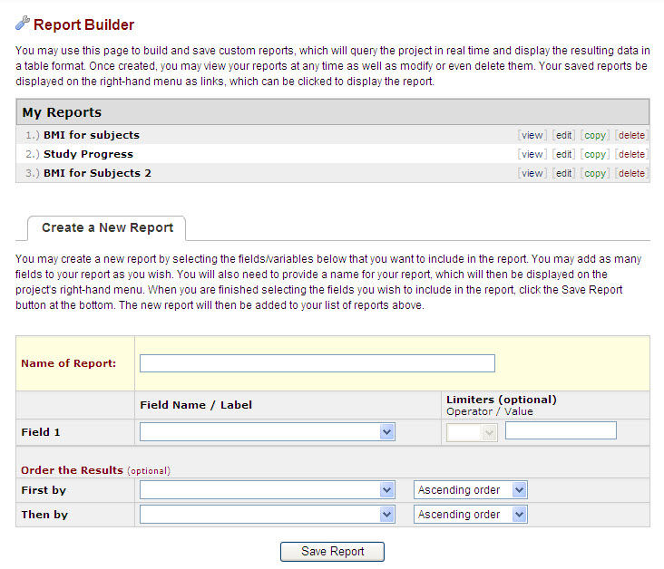
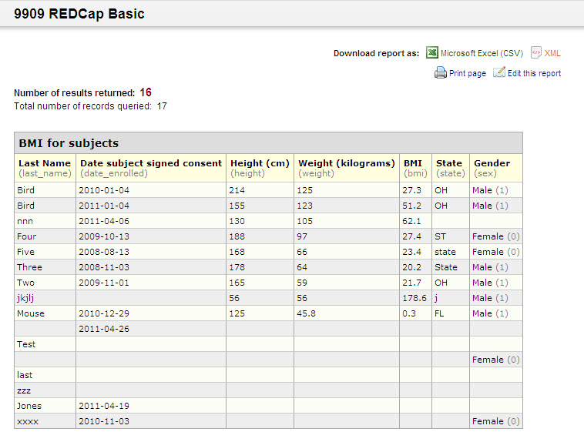
Ad Hoc Report Builder
Create / Save / Export
Reports using fields, ordering, and filters
Slide Courtesy of: Cathy McGraw, Cincinnatti Center for Clinical and Translational Science Training

Slide 36
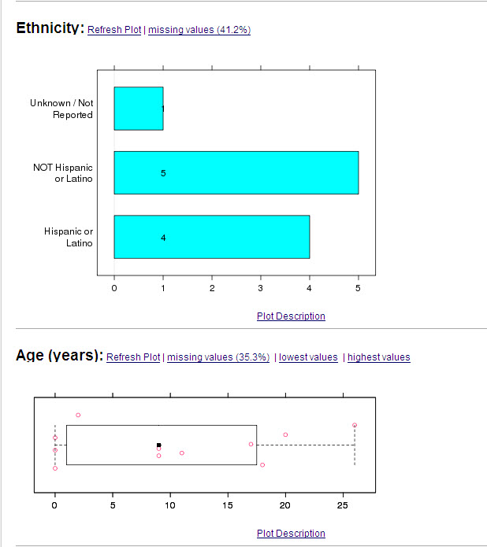
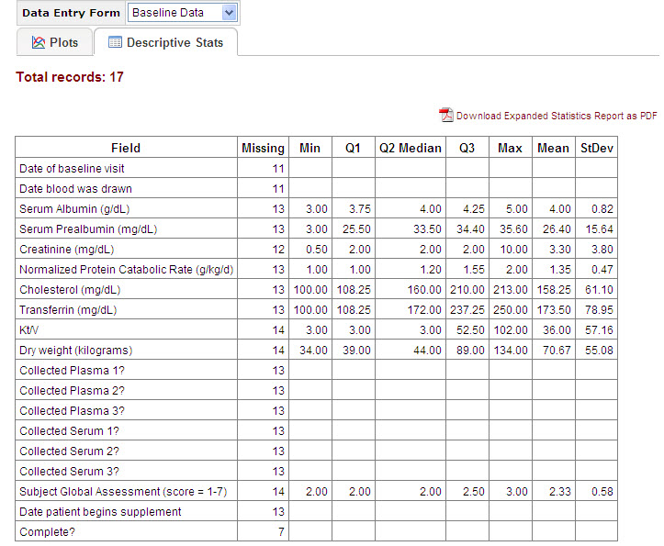
Graphical View and Stats
Real time data
Slide Courtesy of: Cathy McGraw, Cincinnatti Center for Clinical and Translational Science Training

Slide 37
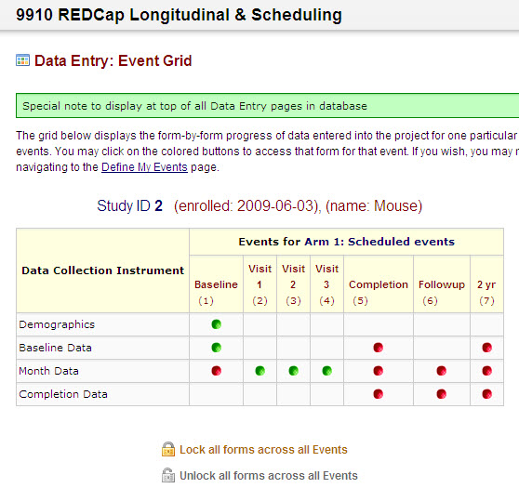
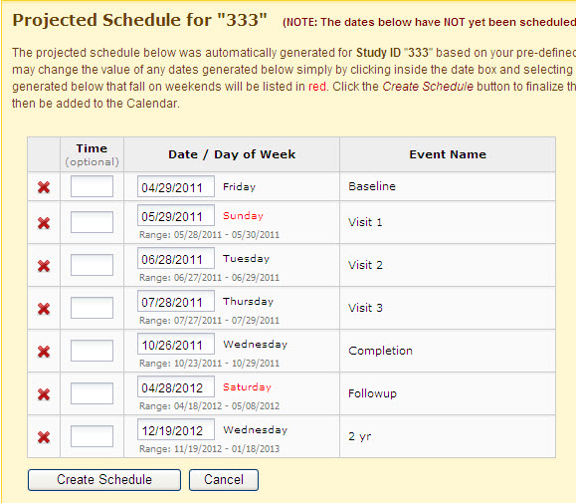
Longitudinal: Forms can be used multiple times
Generate, edit, export schedule for participant and add to project calendar
Slide Courtesy of: Cathy McGraw, Cincinnatti Center for Clinical and Translational Science Training

Slide 38
REDCap Front-End Data Entry
You have 2 options
Survey-based data entry
“Prettier” interface
Public and private audience options
Email tracking system
Form-based data entry
One-stop shop for data entry, scheduling, and data management
Familiar interface, resembles most form-based database software (e.g., MS Access)
Slide Courtesy of: Cathy McGraw, Cincinnatti Center for Clinical and Translational Science Training

Slide 39
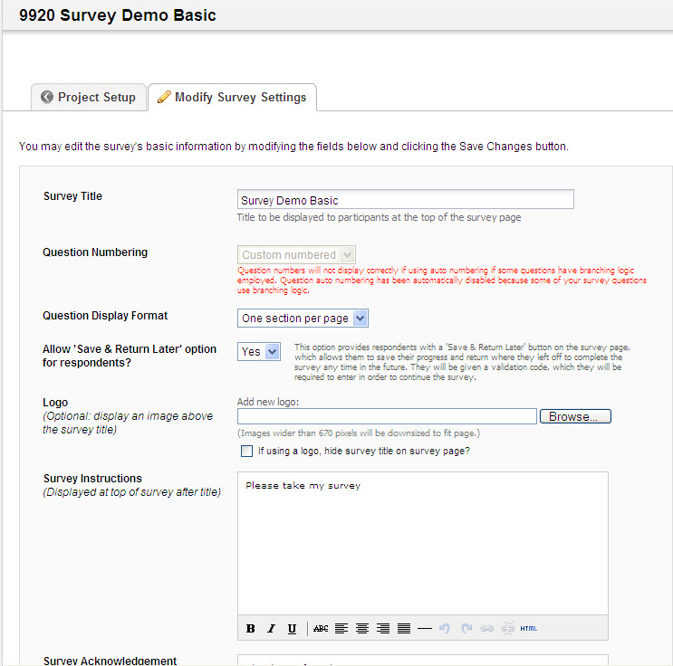
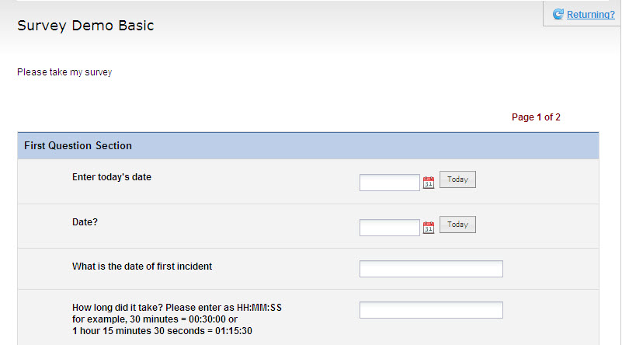
REDCap Survey
Design and data handling same as database
Send link in email or post to webpage
Can invite & manage list of participants
Slide Courtesy of: Cathy McGraw, Cincinnatti Center for Clinical and Translational Science Training

Slide 40
Example: Survey-based Data Entry
Login to REDCap (all instances use OUHSC username and password authentication)
Go to My Projects and select BBMC Demo: Survey
Click “Manage Survey Participants”
Click “Open Survey” button under Public Survey Link tab
Click “Add Participants” link under Participant List tab, then click the icon under the Link field
Notice url
Click “Compose Survey Invitations”
Check email addresses then click “Send Emails”

Slide 41
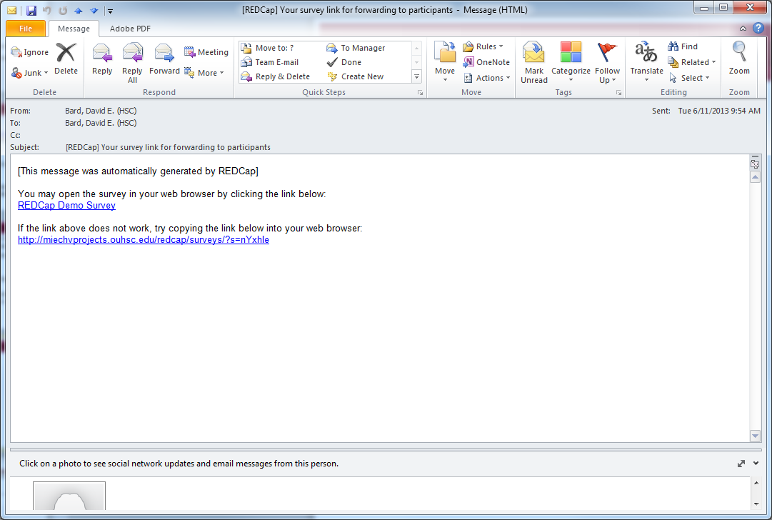
Example: Survey-based Data Entry

Slide 42
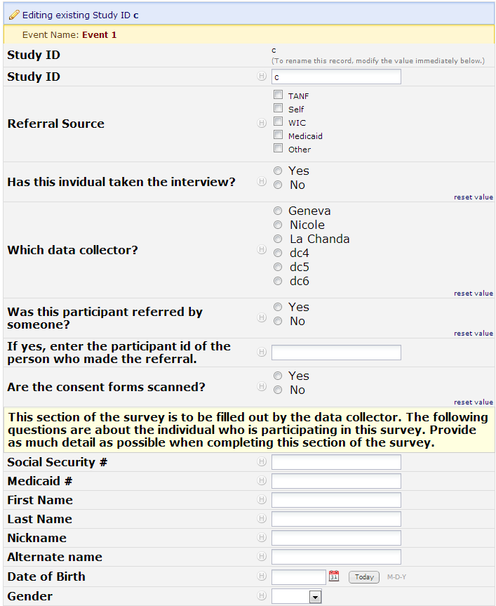
Example Form-based Data Entry

Slide 43
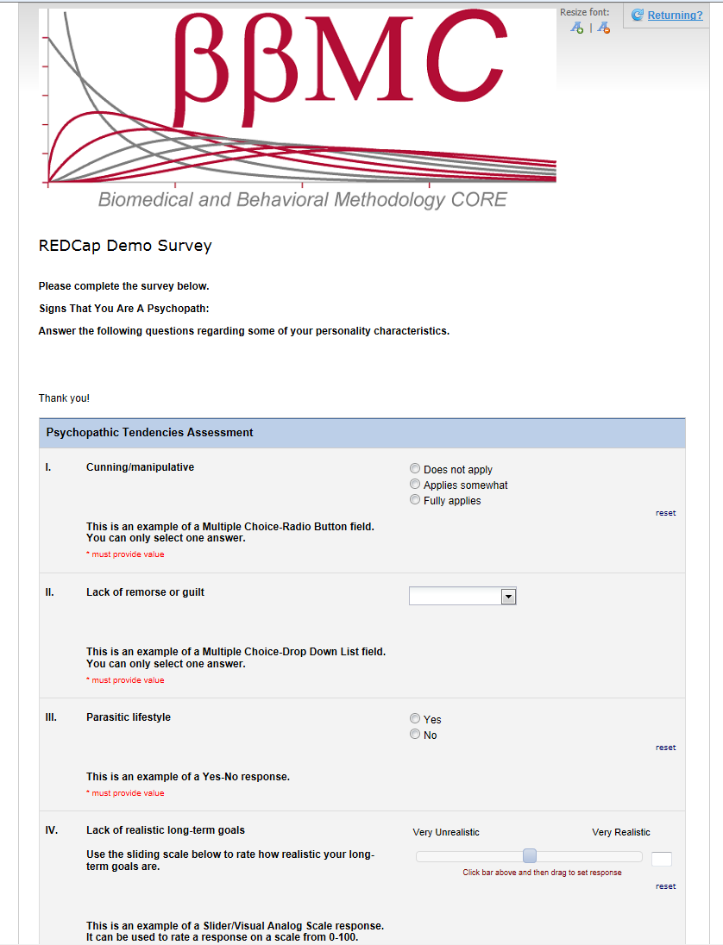
Example Survey-based Data Entry

Slide 44
Data Entry Demonstration
Go to REDCap
Login
Select project “testing123”
Enter some more test data
Create a calendar entry

Slide 45
Data Dictionary Demos
Can create an entire project by uploading pre-existing data dictionary .csv file
Click “My Projects” and select ‘BBMC Demo: Data Dictionary Upload’
Click “Upload Data Dictionary” button and select dictionary file
Change existing field using data dictionary
Click “Project Setup” button, then “Upload Data Dictionary”
Select new dictionary file and “Commit Changes”
Add new fields using data dictionary
Same as change existing fields

Slide 46
Scenarios Favoring REDCap
Project requires a centralized data store, but multiple locations for data entry. - Avoid syncing different locations manually.
You want a flexible, universal framework to create consistent data systems for multiple clinical projects (research and possibly operations). - Reduces your development time & your staff’s training time. - Reduces writing new text for grant proposals and IRB?
Project has a relatively flat data structure.
Typically accommodates 2 or 3 levels well, but is clumsy beyond that. County, Practice, Provider, Patient, Time, Family.

Slide 47
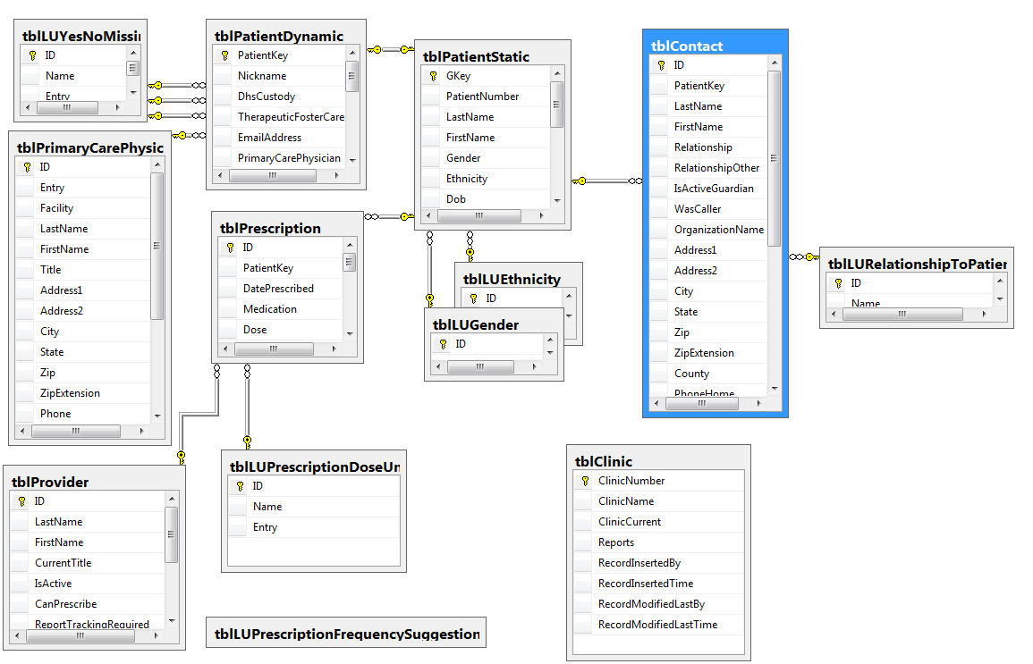
Scenario NOT favoring REDCap

Slide 48
Scenarios Favoring REDCap
No professional software developer on the project
There’s nothing magical about REDCap; it accommodates the designs and needs of many clinical projects.
To develop a comparable system from scratch, you’d need experience with several technologies.
There are lots of dimensions and trade-offs when designing clinical research, and REDCap is close to the sweet spot for most designs.
Candidate for replacing Access, Survey Monkey, Excel.

Slide 49
Feature | REDCap | Qualtrics
Data Dictionary | Y | ?
Data Import | Y | n
Data Export & Summaries | Y | Y
E-mail survey | Only using a survey form, not a data collection form. | Y
Copy other surveys | Y | n
Survey templates | n | Y
Branching logic | Branching logic for individual Qs. | Branching for individual Qs and for groups of Qs.
Audio capabilities | Done via html | ?
Expiration capabilities: (eg, 1 week to respond) | n | Y
Spell check | n | Y
API | Y | n
Free to academic institutions | Y | n?
Offline data capture | Currently, there is not an official REDCap offline data capture component. However, CCAN has created an "in-house" off-line version of REDCap that is currently in use.
Our exposure to Qualtrics is limited. Please don’t interpret this as the authoritative guide.

Slide 50

Accessing OUHSC REDCap
OUHSC REDCap website:
http://ouhsc.edu/bbmc/ and click on REDCap

Slide 51
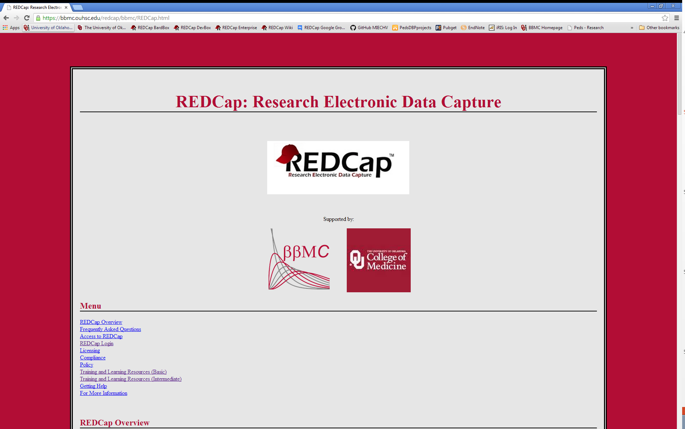
Accessing OUHSC REDCap
OUHSC REDCap website:
http://ouhsc.edu/bbmc/ and click on About REDCap

Slide 52
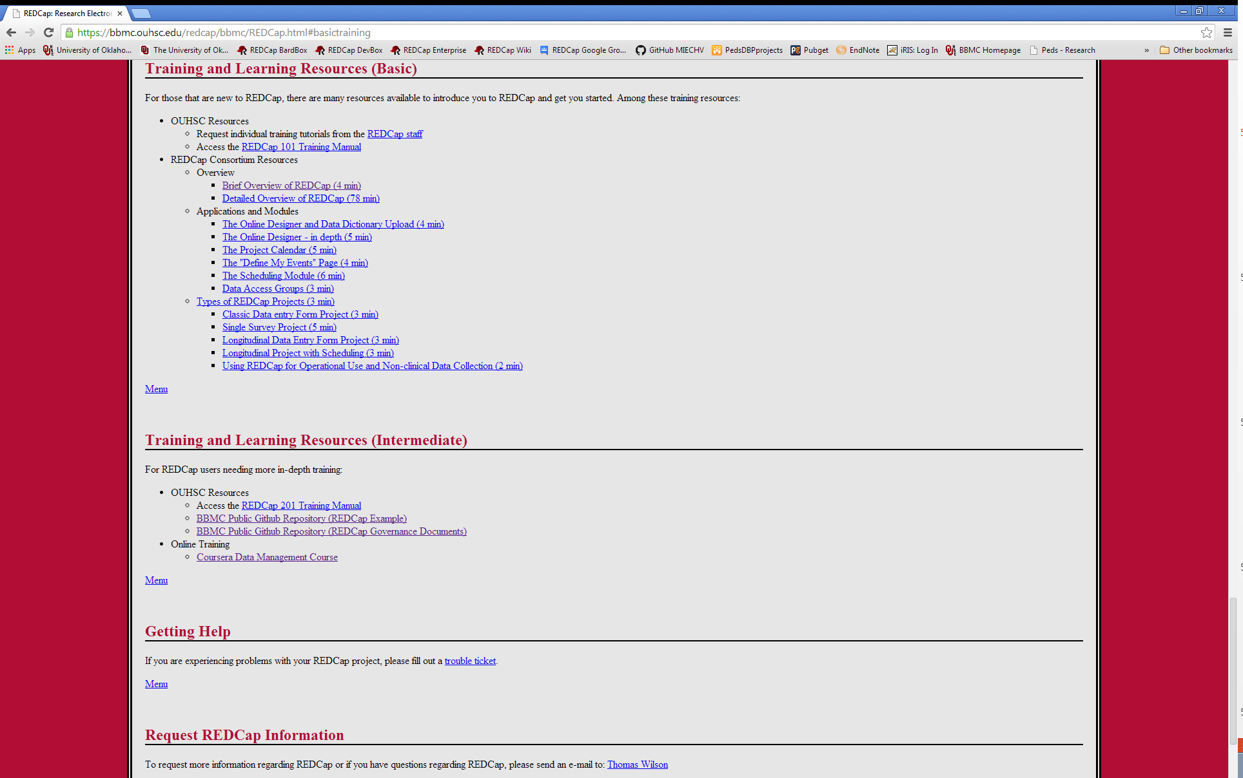
Accessing OUHSC REDCap
Free Local REDCap Training Available!

Slide 53
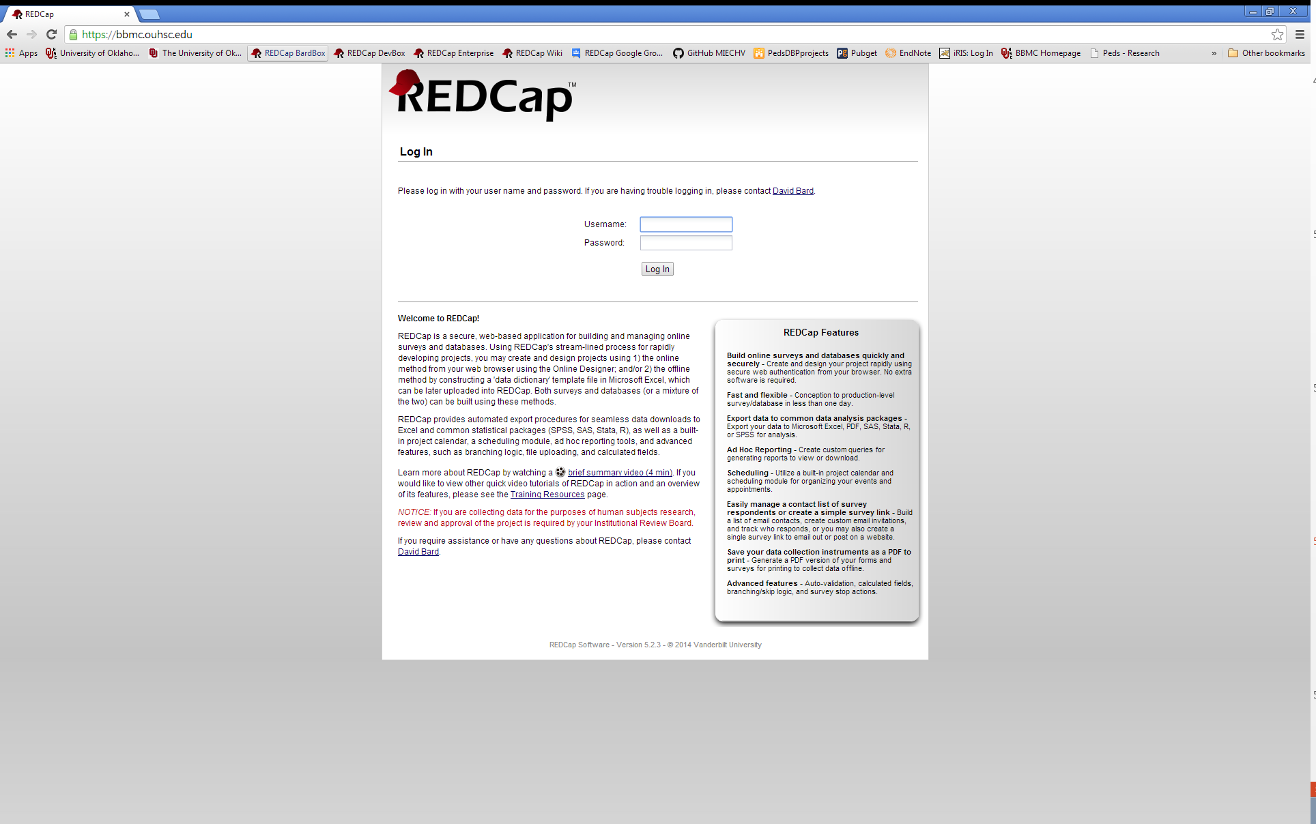
Accessing OUHSC REDCap
Two Live REDCap Instances:
The BBMC Box
https://bbmc.ouhsc.edu/

Slide 54
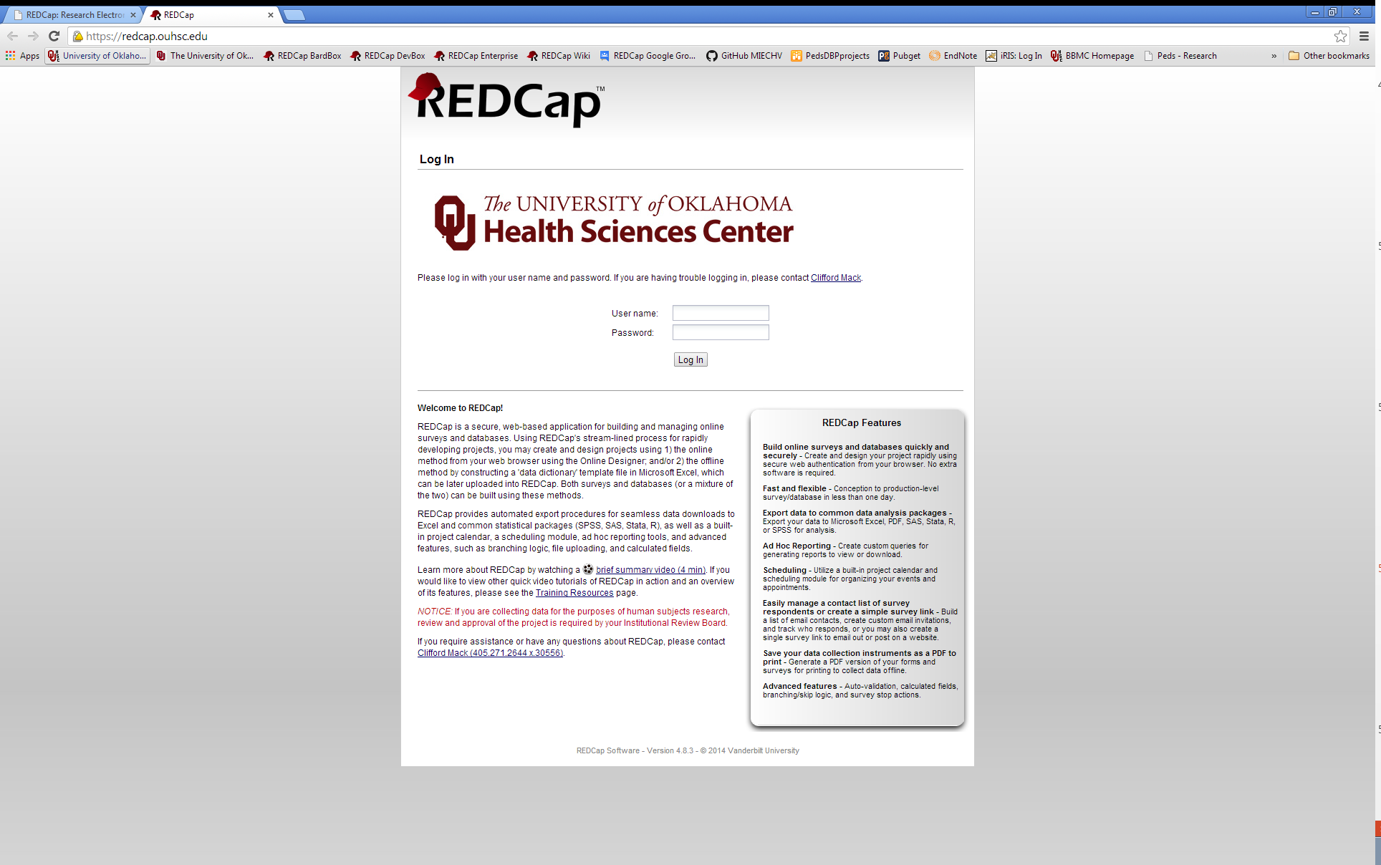
Accessing OUHSC REDCap
Two Live REDCap Instances:
The BBMC Box
https://bbmc.ouhsc.edu/
The Enterprise Box
https://redcap.ouhsc.edu/

Slide 55
Intro to Security Concepts
College of Medicine has devised a REDCap governance body to oversee data security concerns
In a nut-shell, looking to see if investigators and staff have proper IRB clearances for storing PHI on REDCap.
Will provide general advice on secure best practices
To gain access to REDCap, you must have seal of approval of this governance body
Please visit REDCap website to initiate request and review security policies and procedures under Compliance links
https://miechvprojects.ouhsc.edu/redcap/BBMC/redcap.html
After request is initiated, the REDCap Appropriate Use Policy must be reviewed and the REDCap Data Use Agreement must be signed (BBMC will circulate after request is made)
https://miechvprojects.ouhsc.edu/redcap

Slide 56
Citing REDCap in Grants/IRB
How should I describe REDCap in grant or IRB applications?
Data for this study will be entered into REDCap, a database software system developed by Vanderbilt University for electronic collection and management of research and clinical trial data. REDCap uses a MySQL database via secure web interface with data checks used during data entry to ensure data quality. REDCap includes a complete suite of features to support HIPAA and FERPA compliance, including a full audit trail, user-based privileges, and integration with the institutional LDAP server. REDCap also enables automated export mechanism to common statistical packages (SPSS, SAS, Stata, R/S-Plus), simultaneous multi-user and multi-site access, full control over individual-level data access permissions, and remote survey and form-based data capture methods. REDCap technical support is provided by the Biomedical and Behavioral Methodology Core of the Department of Pediatrics, College of Medicine. The MySQL database and the web server will both be housed on secure servers operated by University of Oklahoma Health Sciences Center Information Technology. The entire database system exists on virtual servers that reside in a high availability cluster, and in the event of a hardware related problem, these databases will simply relocate to another server location in the cluster. The database servers are configured for nightly exports that are then backed up using an enterprise backup solution. Backups are retained for up to 90 days. The OUHSC IT servers provide a stable, secure, well-maintained high-capacity data storage environment, and both REDCap and MySQL are widely-used, powerful, reliable, well-supported systems. Access to the study’s data in REDCap will be restricted to the members of the study team by username and password.

Slide 57
Citing REDCap in Manuscripts
How should I cite REDCap in study manuscripts?
Study data were collected and managed using REDCap electronic data capture tools hosted at the University of Oklahoma Health Sciences Center.¹ REDCap (Research Electronic Data Capture) is a secure, web-based application designed to support data capture for research studies, providing: 1) an intuitive interface for validated data entry; 2) audit trails for tracking data manipulation and export procedures; 3) automated export procedures for seamless data downloads to common statistical packages; and 4) procedures for importing data from external sources.
¹ Paul A. Harris, Robert Taylor, Robert Thielke, Jonathon Payne, Nathaniel Gonzalez, Jose G. Conde, Research electronic data capture (REDCap) - A metadata-driven methodology and workflow process for providing translational research informatics support, J Biomed Inform. 2009 Apr; 42(2): 377-81. Link to article: http://dx.doi.org/10.1016/j.jbi.2008.08.010

Slide 58


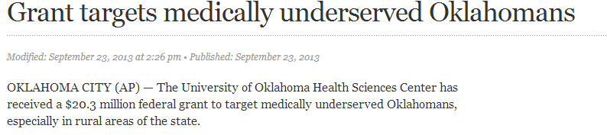
Thank You!
http://ouhsc.edu/bbmc/
Comments or Questions???
Oklahoma Shared Clinical and Translational Resources program
http://ouhsc.edu/bserdac/projects.asp

Slide 59
Advanced Uses of REDCap

Slide 60
Project Management with REDCap
While the original intent of the development of REDCap was to provide researchers with a secure web application for research, a REDCap project can be designed to simultaneously aid in project management and productivity monitoring.

Slide 61
Productivity Monitoring
What do you want to monitor?
Productivity indicators can be incorporated in the original design phase of a REDCap project, or added to an existing project.

Slide 62
MIECHV Project Productivity Indicators
Community Survey Recruitment
Total recruitment calls made
Time spent on recruitment calls
Average time per recruiting call
Number of recruits who agreed to participate
Percent of recruits who agreed to participate
Community Surveying
Total interviews completed
Time spent conducting interviews
Average time per interview

Slide 63
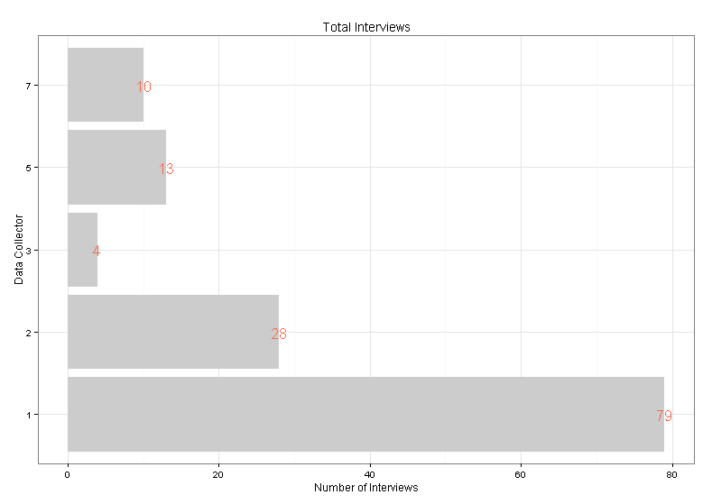
Example Report (Project Aggregate)

Slide 64
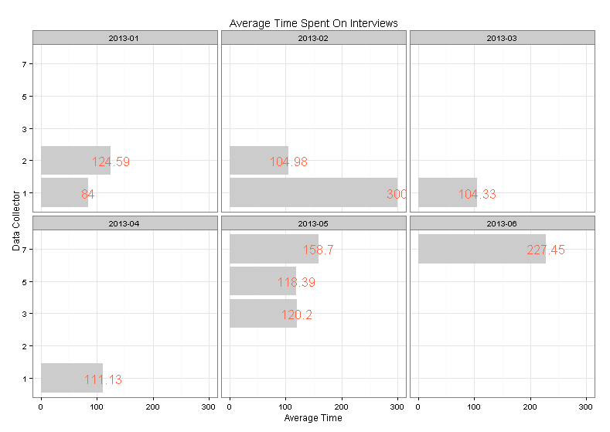
Example Report (6 Month History)

Slide 65
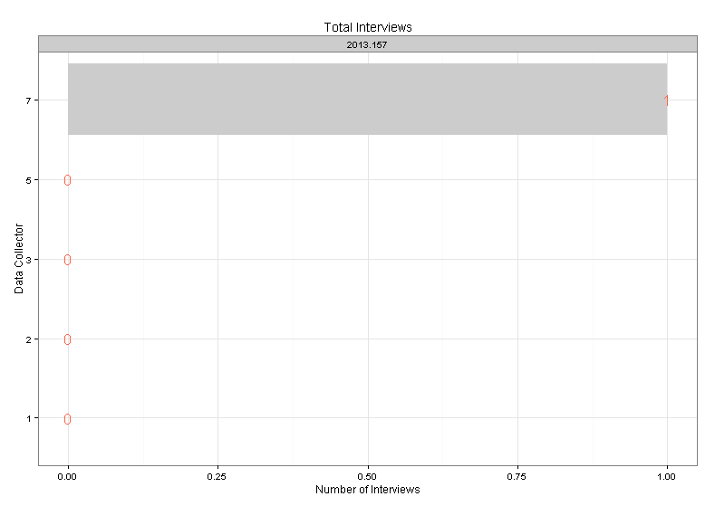
Example Report (7 Day History)

Slide 66
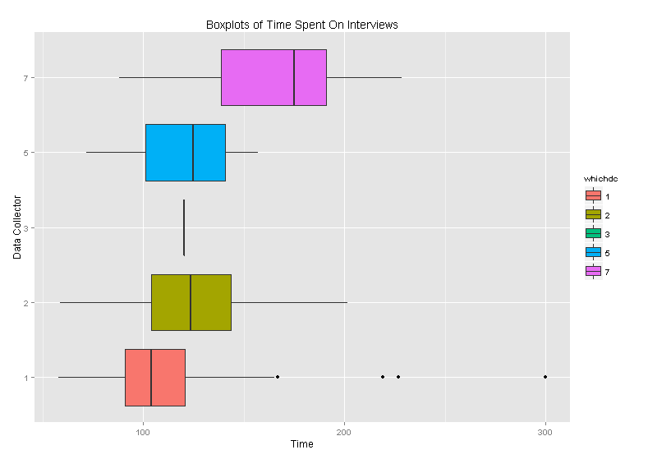
Example Report (Project Aggregate)

Slide 67
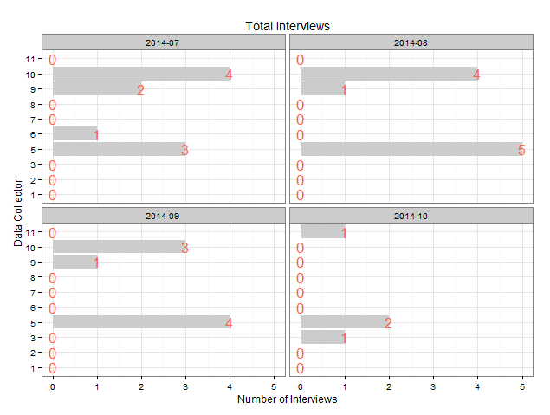
Example Report (4 Week History)

Slide 68
REDCap Advantages
Flexibility:
Productivity indicators established by project team
Reporting methods determined by project needs
All aspects are customizable
Current and historical reports
Automated:
Not necessary to compile data
Real-time data availability

Slide 69



Reports for Outcomes: within REDCap
Accommodates basic descriptives & graphs, but not much more.

Slide 70
Reports for Outcomes: outside REDCap
Use automation to present results in a coherent document.
Eliminate the need to repeatedly copy & paste:
Multiple descriptives, graphs, and model results.
Updated results after more data trickles in.
Internal vs. External Audiences

Slide 71
Reports for Outcomes: Examples
Descriptives & graphs for internal audiences.
Tables for external audiences.
Text and Graphs for external audiences.
Optionally hosted online. https://github.com/OuhscCcanMiechvEvaluation/MReporting/blob/master/OhcaReports/OhcaReport1/OhcaReport1.md

Slide 72

Quick for Internal Audiences

Slide 73

Text and Graphs for External Audiences

Slide 74
Text and Graphs for External Audiences

Slide 75

Text and Graphs for External Audiences

Slide 76

Text and Graphs for External Audiences

Slide 77

Text and Graphs for External Audiences

Slide 78

Tables for External Audiences

Slide 79

Quick for Internal Audiences

Slide 80

Quick for Internal Audiences

Slide 81
Goals
Reproducible research.
Facilitates scientific replication.
Disseminates techniques to other subfields.
Promotes cumulative research.
Literate programming.
Evaluated programs need fresh & frequent feedback.
Collaborative Development.

Slide 82
Collaboration among
The 4 statisticians on the project. sharing software development.
The 20 people on the project. exchanging participant-level data.
The 3 partnering organizations. (OSDH, WIC, OHCA) -receiving their subject-level & agency-level data. -distributing our results –fresh & frequently.
Academics in different areas. (particularly at OUHSC) exchanging tools and workflows.
Researchers in other states pursuing similar goals. publishing ideas and replicating previous work.

Slide 83
Thank You!
http://ouhsc.edu/bbmc/
Comments or Questions???
Oklahoma Shared Clinical and Translational Resources program
http://ouhsc.edu/bserdac/projects.asp

